Slide 1
Mojaloop TigerBeetle
Integration
PI-18 OSS Community Meeting
26 April 2022
Jason Bruwer, Matseliso Thabane
Notes:
We have the pleasure of the end-of-day shift, thank you for still being here!
We are 2 of a team of about 6 people who have been thinking about and working on the design, development and testing of TigerBeetle, which began with a prototype in 2020. So, shout-out to the team members that have joined us remotely.
The goal is to build a specialised database that natively implements financial accounting logic that is usually handled in the application layer.
Today Jason and I are sharing about our progress with integrating TigerBeetle into the Mojaloop Central-Ledger.

Slide 2
Agenda
Progress Update
Hub Architecture
Solution Design
Components
Interaction
Data Migration
Notes:
We will share an update of work done in this past PI
We will briefly look at an example of the architecture of a hub, then zooming into the design of the proposed solution
Jason will take us through the actual components that make the solution
And then he’ll cover how these components interact with the existing Central-Ledger components for a subset of use-cases
If there’s time at the end, we will briefly talk about the artefacts needed for an existing environment interested in testing or implementing TigerBeetle

Slide 3
Progress Update
Key objectives | Implement & test integration into Central-Ledger. Complete the design documentation.
Progress | Documentation Chart of Accounts for use-case subset [draft ready] Solution Design Document [80%] Development Implement & test the NodeJS Interface [75%] Integrate & test NodeJS client [75%] Finalise performance test suite [95%]
Notes:
For this past PI, our goals were to implement and test integrating TigerBeetle into the Central-Ledger for
managing the lifecycle of Participant accounts and for processing, storing & retrieving accounts and balances for transfers.
To be able to test, we needed a base definition of the chart of accounts for each use-case.
This is a starting point that defines
what accounts are required for each user journey
how they are impacted during transaction processing
if and how operational tasks and back-office processes impact the accounts (thinking about status, queries, reporting)
So a draft of the chart of accounts is ready for community review & discussion. We would really value feedback on this initial thinking, of noting a different hub schema might define its chart of accounts quite differently.
A Solution Design Document is also in the works - its intention is to communicate the vision, design detail and requirements for using TigerBeetle as part of a Mojaloop system deployment.
Overall we have completed about 80% of Dev. planned for this PI, that is building and testing a TigerBeetle NodeJS Interface; the client and finalising a performance test suite.

Slide 4
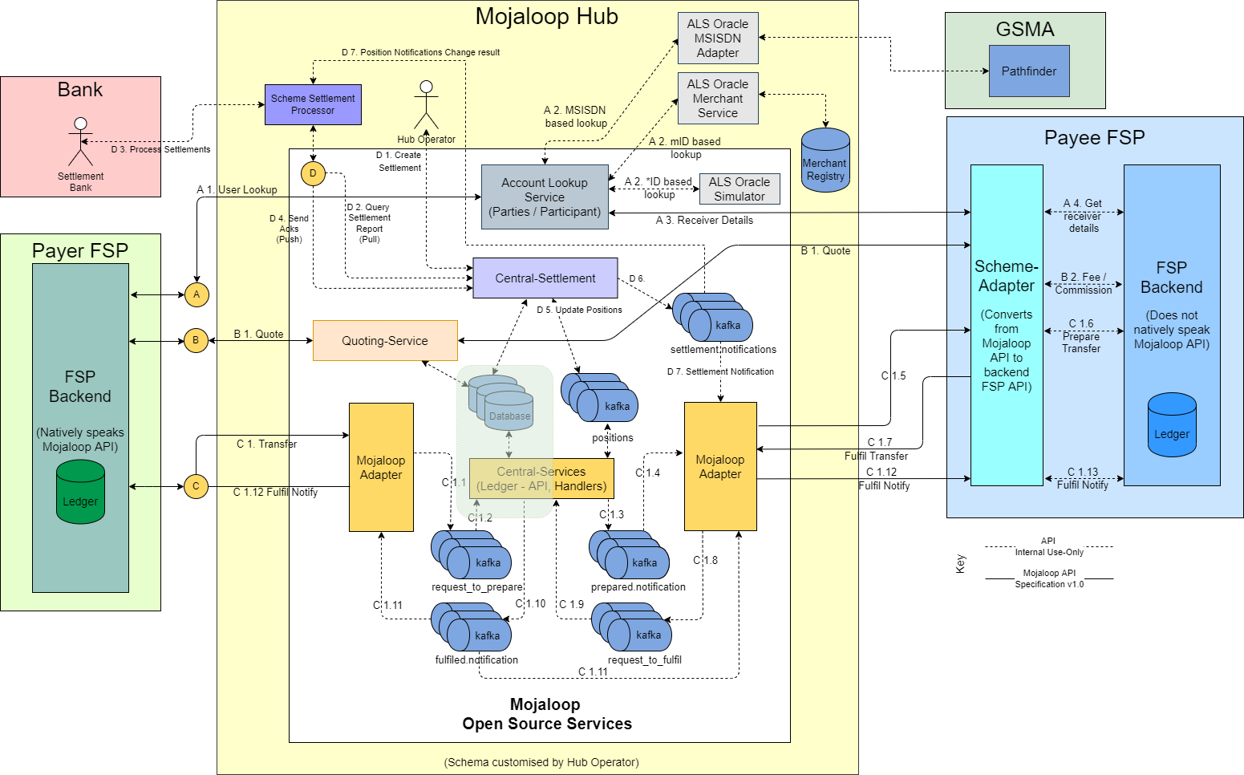
Hub Architecture - Example
Notes:
This will probably be quite a familiar diagram that illustrated the architecture of a Mojaloop hub, based on a particular schema.
All I want to do here is show where our integration work focuses on.
So, let us go a level lower into this area that is shaded

Slide 5
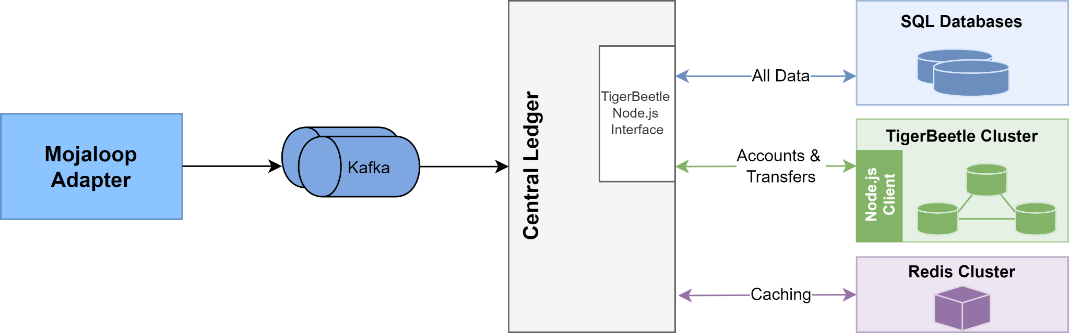
Solution Design
Notes:
On the previous image, we saw that the Mojaloop Adapter communicates with Central-Services via Kafka, and Central Ledger is a part of Central-Services.
For persistence, we see Central Ledger using its existing databases alongside TigerBeetle, with the critical path for a transaction flow being determined by the TigerBeetle interface (NodeJS).
The Central Ledger’s interactions for accounts and transfers are primarily with TigerBeetle, with the current SQL databases asynchronously storing all other data.
The Participant data caching continues to be managed by Redis.
This is where I handover to Jason to move us into the component detail.

Slide 6
Components
TigerBeetle Clients
Native client (Zig)
C used to integrate language platform mappings
Clients in NodeJS & Golang
TigerBeetle NodeJS Interface
Configuration file (default.json)
Data Mapping
Protocol Translation
Orchestrating interactions with TigerBeetle
Notes:
Jumbo!
Thank you Tseli.
Thank you for joining us for the TigerBeetle update. For those of you who do not know TigerBeetle:
TigerBeetle is a financial accounting database designed for mission critical safety and performance, to power the future of financial services.
In our P-17 convening, we demonstrated the integration of Central-Ledger in TigerBeetle, with regards to safety & performance.
Today we will be going into more detail on how & where this integration is made possible.
We will start with the TigerBeetle Client…. Low level to high level.
TigerBeetle Clients
The Zig Native client performs the integration with the TigerBeetle cluster. The Zig client will be integrated into any of the required platforms, such as NodeJS, Go, Java, C# etc.
Since Zig is very C friendly… & can actually be used as a C & C++ compiler to the most popular target platforms, it makes sense to harness the C power of Zig to ease integrations.
This means that the mappings, testing, complexity & effort for each programming language is greatly reduced for the TigerBeetle clients.
Essentially only a mapping is required between the TigerBeetle Zig native client & platform specific client (such as NodeJS in the Central-Ledger example).
We will be going into detail later with the TigerBeetle client implemented in NodeJS (also referred to as tigerbeelt-node).
The TigerBeetle clients already implemented:
Zig
Go
NodeJS

Slide 7
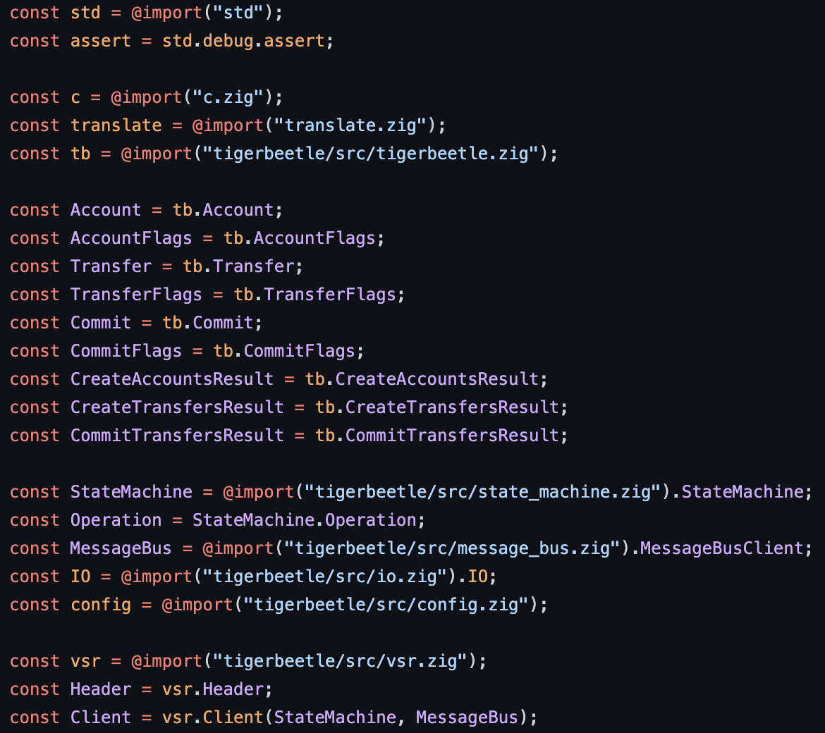
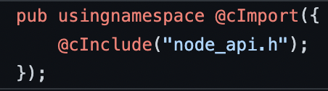
TigerBeetle NodeJS Client
node.zig invoking the TigerBeetle Zig native client:
Import Node C header into Zig (c.zig):
Notes:
The snippet on the left, is where the node API header is being imported in the zig code.
The snippet on the right is where the TigerBeetle client types meet the Node API.
Node API import c.zig
Focusing on the snippet on the left, the node API is now integrated into Zig via the
@cImport - Function, which parses C code & imports the functions, types, variables, & compatible macro definitions
@cInclude function then appends the Node API to the temporary buffer in Zig.
Looking at the image on the right, node.zig references c.zig
Declaring the c constant variable allows access to the required Node API functions, while (top arrow)
the last line on the right snippet creates an instance of the TigerBeetle client.
The code in-between is all TigerBeetle specific in order to communicate with the message bus and state machine (bottom arrow)
This integration concludes the log-level integration for TigerBeelte and NodeJS.

Slide 8
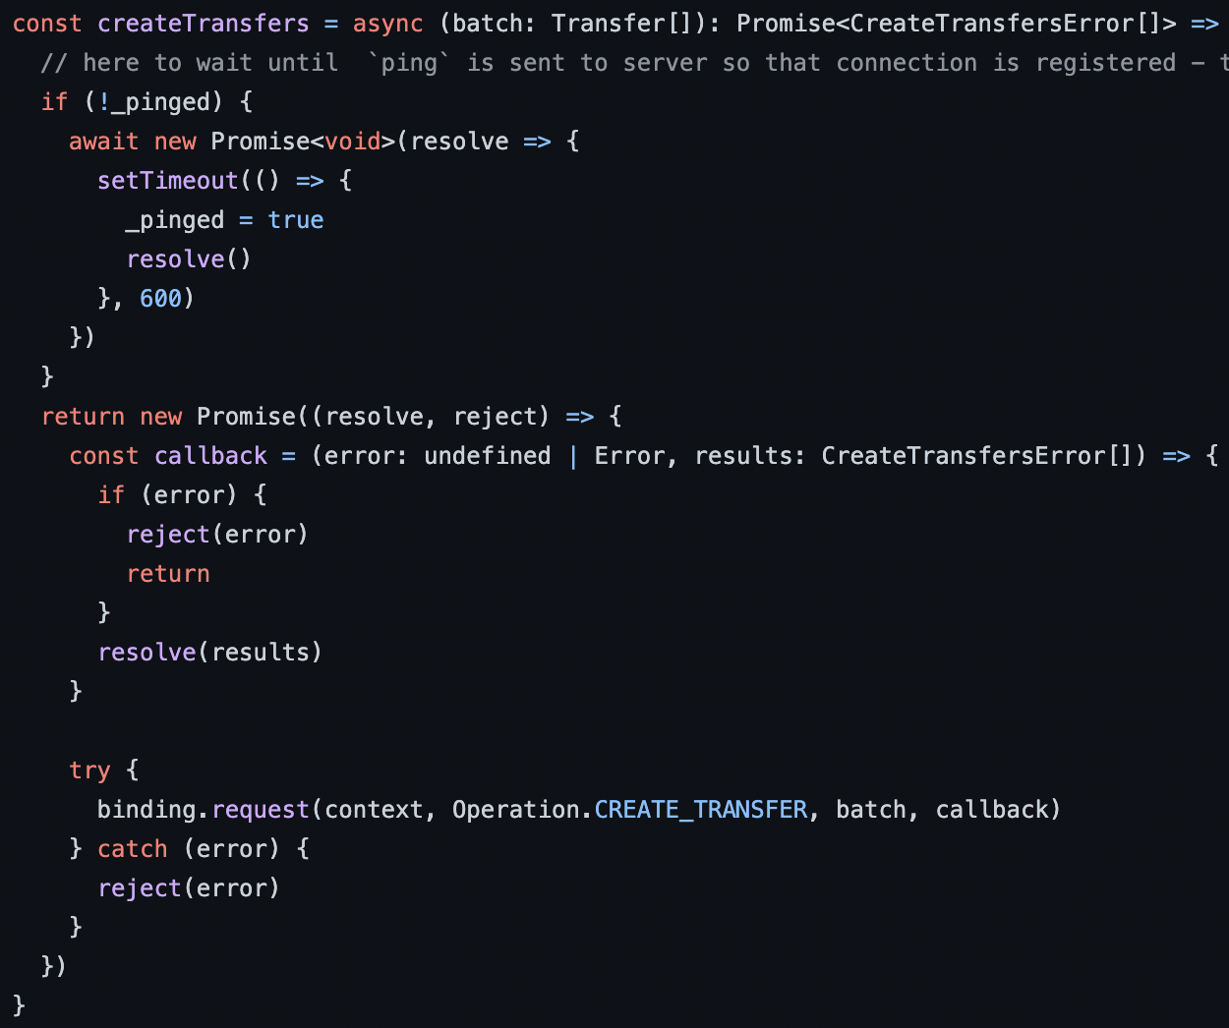
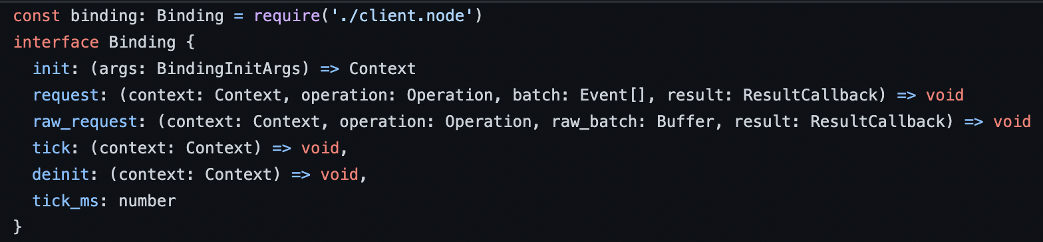
Build Process of the Client
The build:zig script for package.json in tigerbeetle-node repo:
1
3
The binding for client.node in index.ts:
2
Function example createTransfers:
4
Notes:
As part of the tigerbeetle-node build process, the code in the previous slide will be compiled and the output binary placed at dist/client.node location.
package.json
From the top (arrow #1), the build:zig NodeJS script shown here from package.json, is where the zig code is compiled to create the client.node binary for the tigerbeetle-node integration.
index.ts
Looking at arrow #2, the index.ts TypeScript imports the client.node module, where the integration is being created between TigerBeetle & NodeJS.
createTransfers
On the right (arrow #3), we can see the createTransfers typescript function exposed to create Transfers in TigerBeetle.
Then further down at arrow #4, we can see the client.node binding being invoked to create the transfer.
The full integration in NodeJS is less than 900 lines of code (keeping in mind, client code only), which is awesome.

Slide 9
Components
TigerBeetle Clients
Native client (Zig)
C used to integrate language platform mappings
Clients in NodeJS & Golang
TigerBeetle NodeJS Interface
Configuration file (default.json)
Data Mapping
Protocol Translation
Orchestrating interactions with TigerBeetle
Notes:
Now that we have background info on how TigerBeetle clients integrate with the TigerBeetle cluster, we will go into detail of how the integration works within Central-Ledger.
Configuration File
Existing Central-Ledger configuration is updated to support integration with TigerBeetle through the central-ledger configuration file.
Data Mappings
Since TigerBeetle & Central-Ledger make use of different data storage mechanisms & models, it is important to note what data is being stored & referenced in TigerBeetle vs Central-Ledger.
The second part to the data itself, is how & when the data is transported to TigerBeetle from Central-Ledger.
Protocol Translation
Lastly we will be going into detail of how exactly TigerBeetle is being integrated into Central-Ledger though the TigerBeetle interface in Central-Ledger.
The in depth-look will cover the Account & Transfer creation process.
Tseli: Perhaps keep it light, we will be going into detail later.

Slide 10
Configuration file
Update the default.json configuration file to enable/disable TigerBeetle:
"TIGERBEETLE" : {
"ENABLED" : true,
"ENABLE_BATCHING" : false,
"DISABLE_SQL" : false,
"BATCH_MAX_SIZE" : 2048,
"CLUSTER" : 1,
"REPLICA_ENDPOINT_01" : "localhost:5001",
"REPLICA_ENDPOINT_02" : "localhost:5002",
"REPLICA_ENDPOINT_03" : "localhost:5003"
},
TigerBeetle NodeJS Interface
Notes:
The existing default.json Central-Ledger configuration file has a new section called TIGERBEETLE where all the TigerBeetle related configurations for Central-Ledger will be located and configured.
It is important to note that TigerBeetle also has its own configurations that needs to be configured within the TigerBeetle cluster.

Slide 11
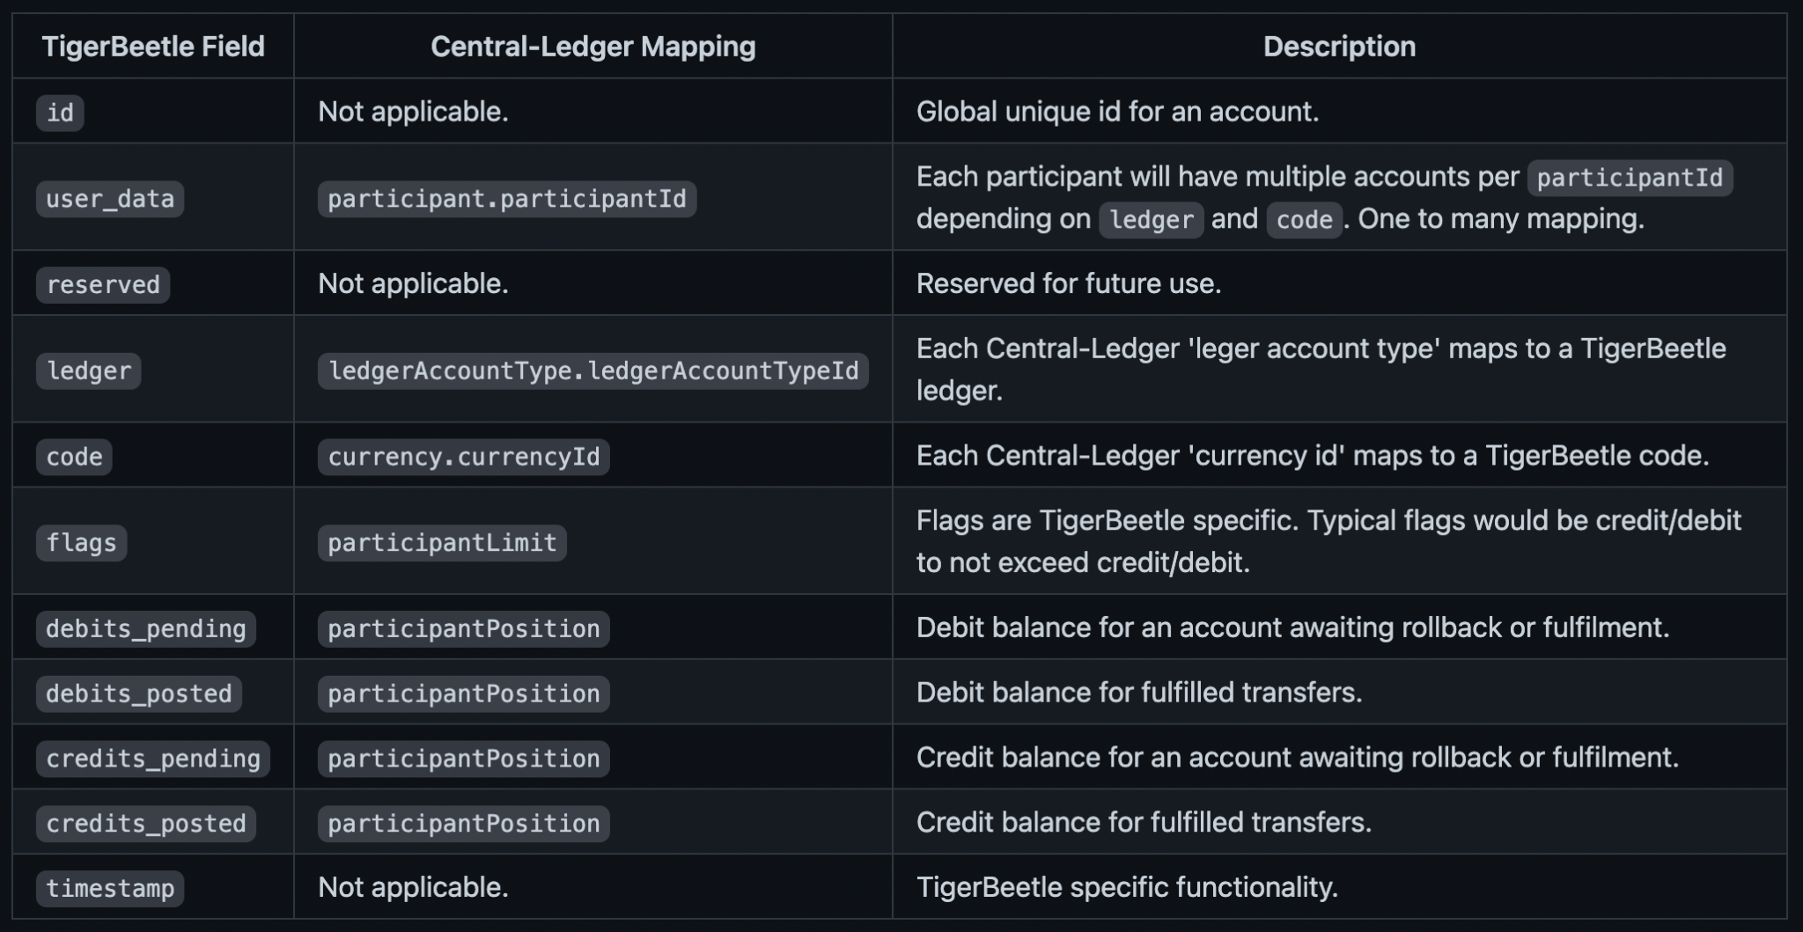
Account Data Mapping
TigerBeetle NodeJS Interface
Notes:
Moving on to data mappings, the table we see here shows the matching fields between TigerBeetle and Central-Ledger, as well as a brief description of each field.
Account Data Mapping
The fields listed to the left, is specific to Accounts in TigerBeetle.
Important fields for Central-Ledger include:
user_data, which is used to link account data from the Central-Ledger database, with the accounts stored in TigerBeetle.
A single user_data field value would reference multiple accounts in TigerBeetle.
The ledger field matches the ledgerAccountTypeId from Central-Ledger, while the code field is linked to the currencyId in Central-Ledger.
The flags for accounts, are TigerBeetle specific, and used to manage account specific properties & functionality, such as:
The credit/debit limits allowed for each account
The linked flag, which is used to link a batch of accounts as part of a chain, which allows the creation of a set of accounts to succeed or fail together
The last set of fields refer to the credit/debit balances in TigerBeetle for an account.
Both the prepare balance as well as the fulfill balance is stored in TigerBeetle.

Slide 12
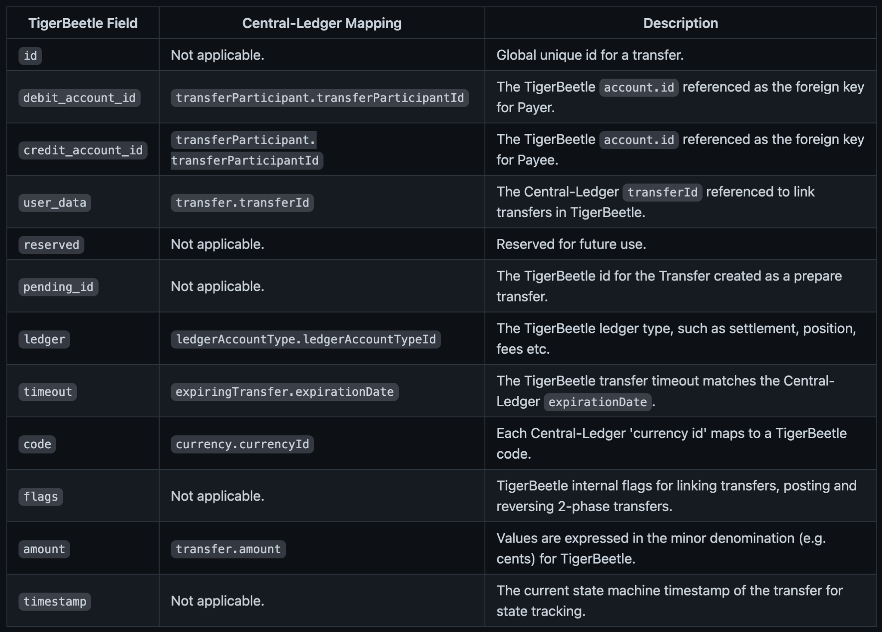

Transfer Data Mapping
TigerBeetle NodeJS Interface
Notes:
Moving onto the Transfer data mapping.
Transfer Data Mapping
This table lists all the of the fields supported by TigerBeetle for a Transfer.
Transfers in TigerBeetle are immutable, unlike accounts.
The payer (debit) & payee (credit) is required to represent a single Transfer, since TigerBeetle financial domain is double entry T-accounts … Note the T on the right. :-)
user_data is used to link transfer data from the central-ledger database, with the transfers stored in TigerBeetle.
The timeout is only applicable with 2-phase transfers, which in turn is managed by the Transfer flags.
The flags for Transfers are used to manage transfer specific properties & functionality, such as:
The linked flag to link a batch of transfers as part of a chain, this allows the creation of a set of transfers to succeed or fail together
Pending flag to mark a transfer as a 2-phase transfer (prepare/fulfil)
The final post_pending/void_pending flags allow one to fulfill or rollback a prepare Transfer

Slide 13
Protocol Translation Library
The tb.js interface transforms the Central-Ledger & TigerBeetle data models.
Some of the main exposed functions are:
tbCreateAccount → Create participant, currency, position and other related data
tbLookupAccount → Lookup using participantId or participantCurrencyid
tbTransfer → Create a transfer
tbPrepareTransfer → Create a 2-phase transfer prepare (with a timeout)
tbFulfilTransfer → Fulfil a 2-phase prepared transfer
tbRollbackTransfer → Rollback a prepared transfer
tbLookupTransfer → Lookup an existing transfer
tbTransferTimedOut → Verify whether a 2-phase transfer has expired
TigerBeetle NodeJS Interface
Notes:
Now that we have background on the clients and data models, we can look at the protocol translation library to cover Central-Ledger and TigerBeetle behaviour.
Integration
The tb.js interface is used to map the Central-Ledger data models with the TigerBeetle data models for Accounts and Transfers.
TigerBeetle stores only the necessary data related to Accounts & Transfers, data such as ilPPacket & transferExtension’s are not stored in the TigerBeetle data set.
Some of the main functions include:
creatingAcccount, lookupOfAnAccount or accounts, transferPrepares and tranferFulfils (for our 2-phase transfer), and last but not least, rolling back a transfer.
Lets go ahead and see how some of these functions are utilized in Central-Ledger.

Slide 14
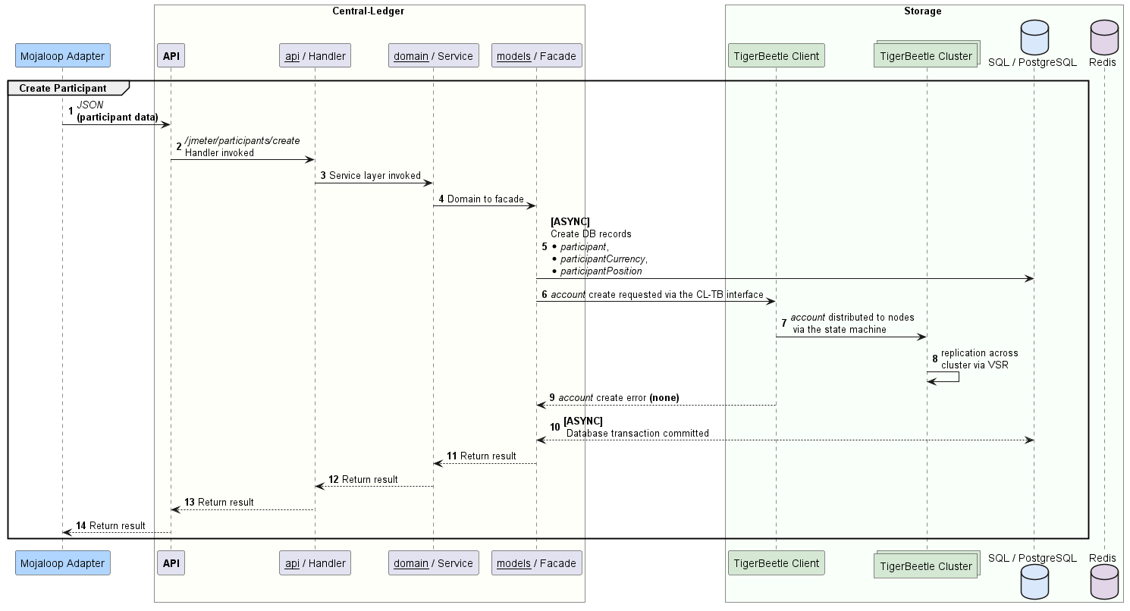
Interaction - Create Participant
Notes:
High Level - Participant / Account Creation
All of the sequence diagrams to follow are taken from the Solution Design document for Central-Ledger and TigerBeetle integration.
We will be focusing on the TigerBeetle integrations with each of the sequences.
It is important to note that the above sequences are not showing the integration from the Kafka consumer, which will be utilized in a real-world scenario.
Instead a jmeter REST endpoint in order to measure performance from the Central-Ledger handlers.
The area we will focus on are steps 5 to 10 for the next slide (the blue block).
The complete Solution Design document will be made publicly available shortly.

Slide 15
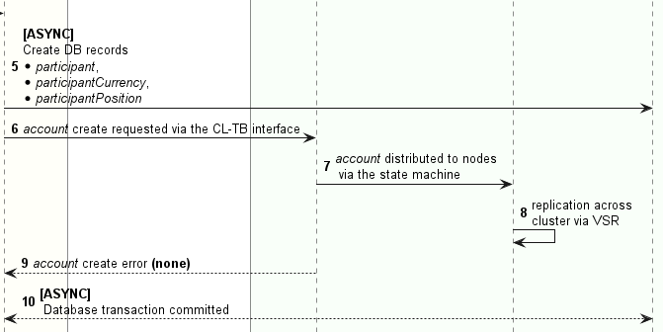
Interaction Detail - Create Participant
Notes:
Create Participant
Starting from step 5.
The Database transaction is initiated to store the participant and account data in the following tables;
participant
participantCurrency
participantPosition
The TigerBeetle client is invoked to create the participant account (tbCreateAccount), which has ties to the Central-Ledger participant tables.
At step 6, The account create request is received by the TigerBeetle cluster. The account is created and distributed to all TigerBeetle nodes in the cluster via VSR (View Stamped Replication).
Only errors for the batched account creation is returned…. and in this case there were no errors.
At step 10, the database transaction is regarded as successful, and the database transaction is committed.
Participant data is only committed once successfully created in both TigerBeetle and Central-Ledger
Duplicated account data is ignored in TigerBeelte.

Slide 16
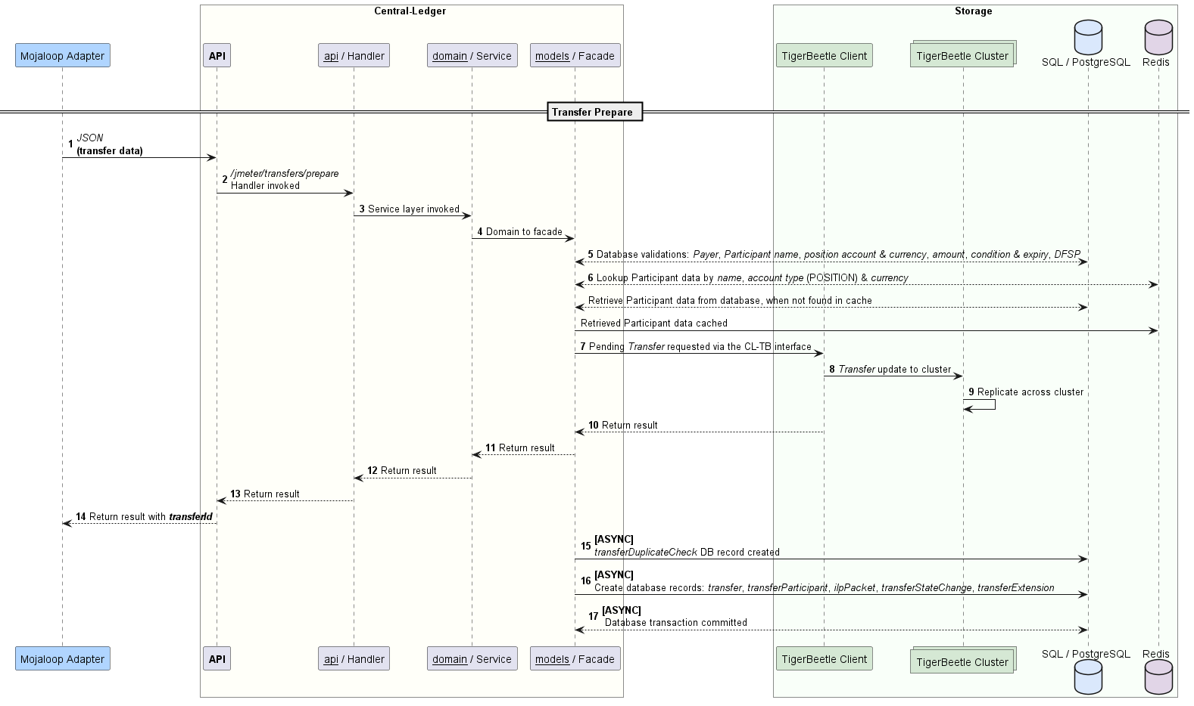
Interaction - Prepare Transfer
Notes:
From Accounts to 2-Phase Transfers.
High Level - Transfer Prepare
The sequence above is the sequence to preparing a transfer.
The area we will focus on are steps 5 to 17.

Slide 17
Interaction Detail - Prepare Transfer
Notes:
tbPrepareTransfer
Starting from step 5.
The following validations are performed prior to the transfer (This is existing validations from Central-Ledger):
validateParticipantByName -> for Payer and Payee
validatePositionAccountByNameAndCurrency -> Asserts account exists for name-currency tuple (discards result of lookup work)
validateAmount -> Validates allowed scale of decimal places and allowed precision
validateConditionAndExpiration -> Validates condition and expiration
validateDifferentDfsp -> Asserts lowercase string comparison of payload.payerFsp and payload.payeeFsp is different
sds
At step 6, a lookup is performed for Payer and Payee Participants data in Redis via name, position account type and currency
If participant data is not available in Redis, a database lookup is performed, followed by the participant data being cached in Redis to be used for subsequent calls
Step 7, Invokes the TigerBeetle prepare Transfer via the TigerBeetle NodeJS client.
In steps 8 & 9, the Transfer is distributed via the TigerBeetle state machine. The transfer is distributed all nodes in the cluster.
The TigerBeetle API responds with the result. Result is returned to the DFSP via the REST API (testing)
Asynchronously the Central-Ledger database is updated:
Inserting a duplicate check for //Transfer// into the transferDuplicateCheck table:
Notice there is no need to perform duplicateCheck prior to creating the transfer for TigerBeetle, since TigerBeetle would have reported an error on creation.
The duplicate check is then followed by an insert into the Central-Ledger Transfer tables:
transfer
transferParticipant (Payer)
transferParticipant (Payee)
ilpPacket (When applicable)
transferStateChange
participantPosition
participantPositionChange
transferExtensions (When applicable)
Lastly, the Transfer related database transaction is committed.

Slide 18
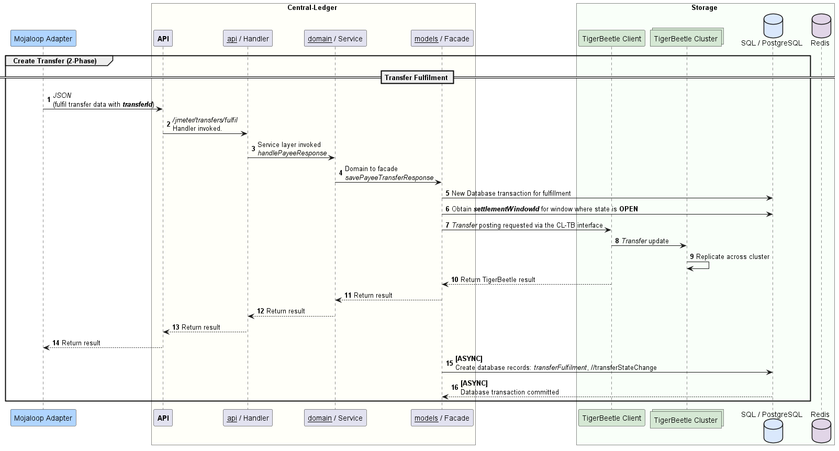
Interaction - Fulfil Transfer
Notes:
Next, we follow up the prepare with a Fulfill transfer.
High Level - Transfer Fulfillment
The area we will focus on are steps 5 to 16.

Slide 19
Interaction Detail - Fulfil Transfer
Notes:
tbFulfilTransfer
Starting from step 5.
A new database transaction is initiated for the //Transfer// fulfil.
The current open settlementWindow data is obtained for the current settlement window, with the OPEN state.
The TigerBeetle client is invoked with a Transfer with post_pending_transfer = true property (also with prepare_id populated for the transfer prepare). This will result in the transfer being fulfilled.
The same replication process applies for the fulfillment Transfer.
The TigerBeetle client API responds with the result of the fulfil transfer.
The Central-Ledger fulfillment data is populated.
transferFulfilment
transferStateChange
Database transaction is committed and result returned to the DFSP via the REST API

Slide 20
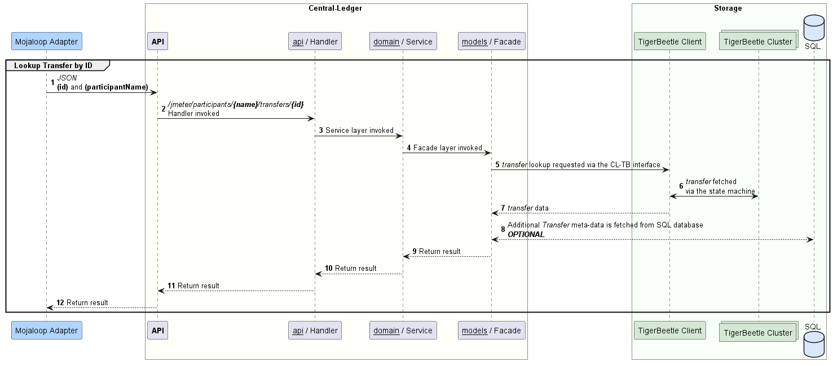
Interaction - Lookup Transfer
Notes:
Now that we have created accounts and stored transfers against those accounts, we can perform lookups on
accounts and transfers.
High Level - Lookup Transfer
The area we will focus on are steps 5 to 8.

Slide 21
Interaction Detail - Lookup Transfer
Notes:
tbLookupTransfer
Keeping with the trend, starting from step 5.
The TigerBeetle client is invoked with a transferId, however, it is also possible to perform range queries for currencies, ledgers and Central-Ledger accounts based on user_data.
Once TigerBeetle transfers are fetched, the balance of the requested data will be fetched from the Central-Ledger database.
This concludes the Central-Ledger TigerBeetle interface.

Slide 22
Data Migration
Default scripts: summary; migrate; verify
Process:
Execute data summary scripts - accounts, balances & transfers
Configure & execute migration scripts
Execute verification scripts
Notes:
The final section I am covering today, is the data migration process for populating TigerBeetle with existing Central-Ledger participant and transfer related data.
Data Migration scripts:
Existing Central-Ledger customers will be able to mirror & onboard all necessary Central-Ledger data though migration scripts.
Data migration to TigerBeetle process includes:
Sanity check & summary of account & transfer data to be migrated as a pre-check script
Migration script of all account related data required for TigerBeetle from Central-Ledger database (in batches)
Migration script of all transfer related data
Post migration, a verification script is provided to:
match Accounts between TigerBeetle & Central-Ledger
match Transfers between TigerBeetle & Central-Ledger
Thank you for listening, over to you Tseli.

Slide 23
Upcoming focus
For the next cycle | Design documentation community input → update & finalise Implement & showcase Central-Settlement integration Implement rich queries (batch, date range, entities) Release JMeter Central-Ledger test suite Demo integration

Slide 24
Questions

Slide 25
Thank you.

